Slide 1

OPS-SAT SPACECRAFT AUTONOMY
NAME:Krushnai Burpalle ROLLNO:2317010
NAME:Srushti Bhosale ROLLNO:2317008
NAME:Aarya Gaikwad ROLLNO:2317025

Slide 2


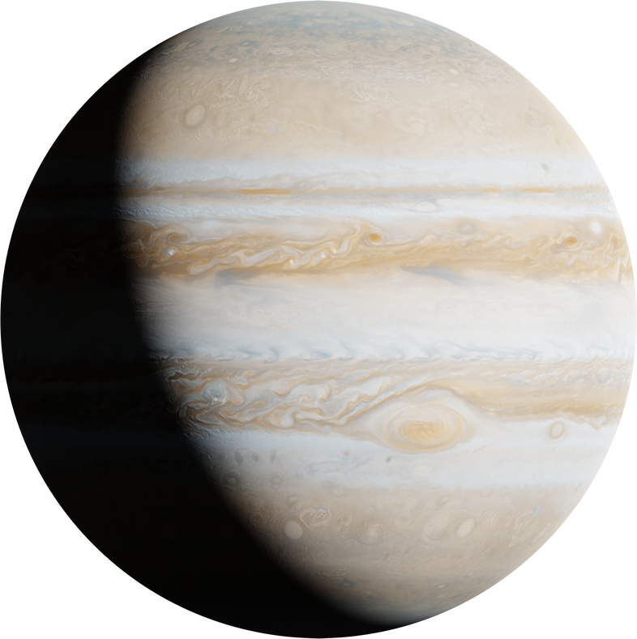
INTRODUCTION
OPS-SAT is a small ESA satellite that tests new ideas in spacecraft operations, focusing on autonomy. It acts as an in-orbit lab for experimenting with advanced tech to boost future space mission autonomy. With a powerful onboard computer, OPS-SAT tests software that can decide without human help, aiming to increase efficiency, cut costs, and support complex missions.

Slide 3


PROBLEM STATEMENT
The OPS-SAT spacecraft autonomy problem revolves around enhancing the satellite's ability to operate independently without continuous human intervention. The challenge is to develop and implement advanced algorithms and systems that enable the spacecraft to make real-time decisions based on its environment and mission objectives. This involves improving onboard processing capabilities for tasks such as navigation, data analysis, and anomaly detection, ensuring the spacecraft can adapt to unexpected situations and optimize its performance while minimizing reliance on ground control.

Slide 4


OBJECTIVE
The OPS-SAT spacecraft autonomy objective, managed by ESA, tests new autonomous operations in space. This small CubeSat serves as an in-orbit testbed for innovative software that could enhance satellite missions. The goal is to improve onboard decision-making, reduce ground control reliance, and enable responsive operations, paving the way for more flexible space missions.

Slide 5

MOTIVATION
OPS-SAT tests innovative software and operational ideas to enhance mission efficiency.
It improves onboard decision-making, minimizing reliance on ground control.
The mission paves the way for future autonomous space explorations by supporting independent spacecraft operations.

Slide 6
APPLICATIONS
Real-Time Decision Making: OPS-SAT autonomously makes quick decisions, reducing ground control dependency.
Anomaly Detection: It detects anomalies and initiates corrections autonomously, ensuring smooth operations.
Resource Management: The spacecraft manages its resources to optimize functionality and extend mission life.
Autonomous Navigation: OPS-SAT independently determines its position and trajectory for precise maneuvers.
Experiment Management: It autonomously schedules and conducts experiments, boosting research efficiency.

Slide 7

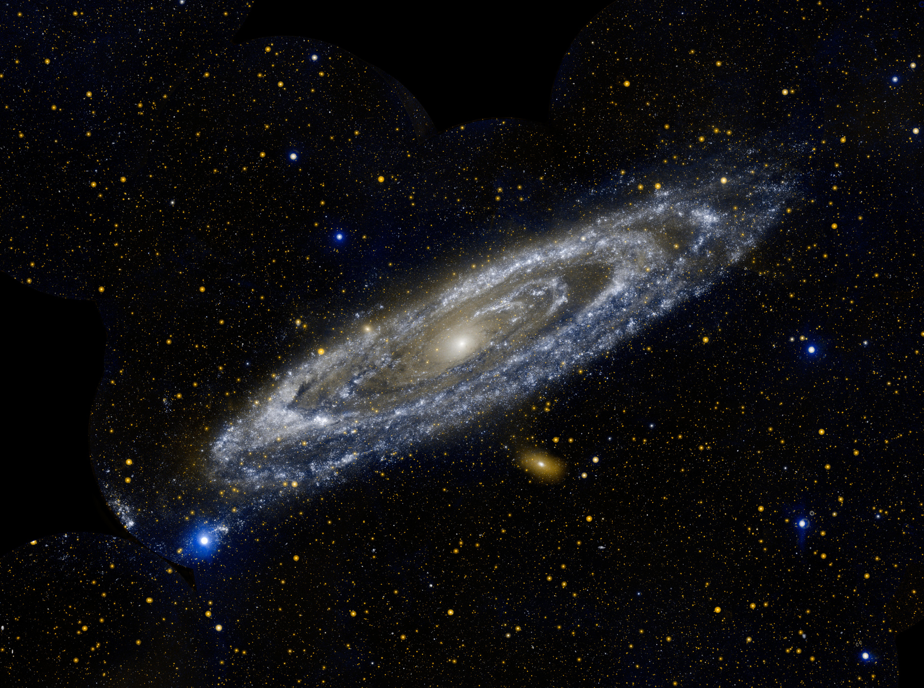
LIMITATIONS
Limited Computational Resources: Its small size restricts computational power, affecting the complexity of algorithms it can run.
Communication Dependence: It relies heavily on ground-based communication for updates and commands.
Environmental Constraints: Challenges like radiation and temperature fluctuations can limit autonomous operations.

Slide 8
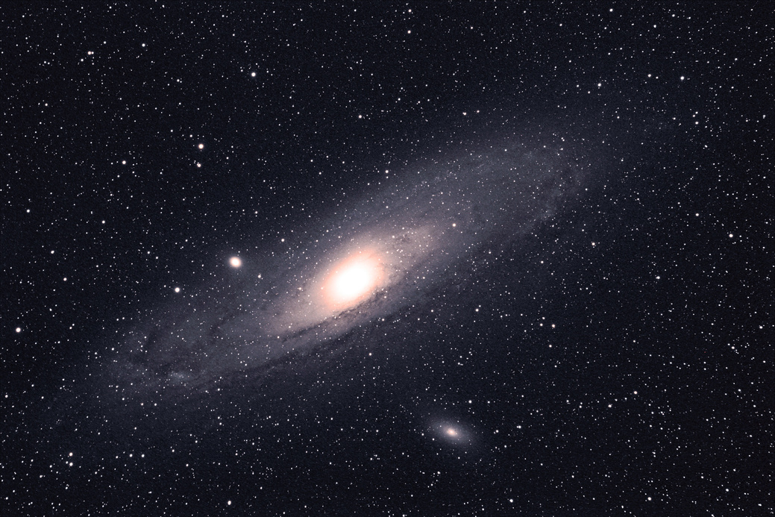

CONCLUSION
The OPS-SAT spacecraft by the European Space Agency demonstrated the potential of increased autonomy in space missions. Serving as a testbed, it enabled autonomous decision-making and operations, showcasing enhanced efficiency and reduced reliance on ground control. This paves the way for future advancements in space exploration.

Slide 9

THANK YOU.

